Slide 1
Predicting Risk of Heart Disease using Machine Learning

Slide 2

Heart Disease
Causes ¼ of deaths in U.S. each year
Leading cause of death
Costs U.S. $200 billion a year in healthcare and lost productivity

Slide 3

Mimic III Dataset
ICU records of 46520 patients
Demographic Information
ICU Records
Anonymized as much as possible

Slide 4
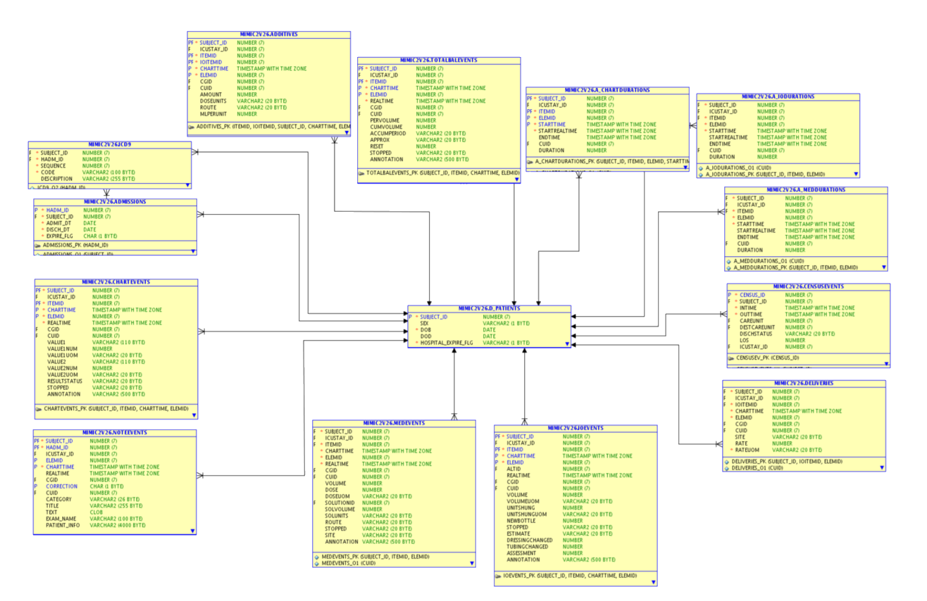

Slide 5
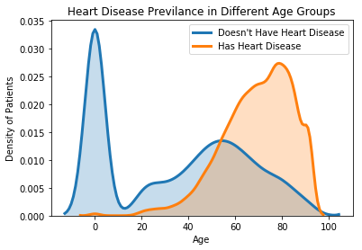

Slide 6
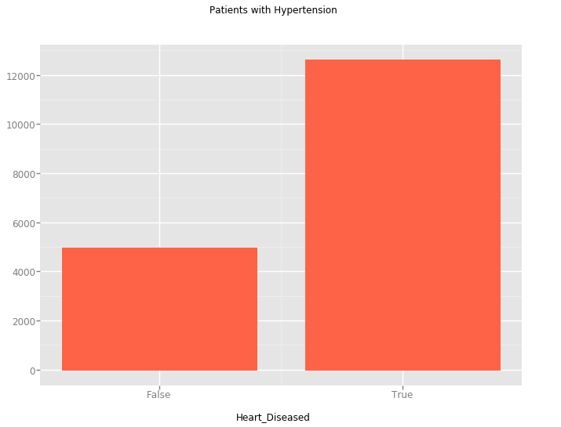

Slide 7
Goal and Variables
Predict whether a patient is at risk for heart disease
Gender
Age
Ethnicity
Religion
Marital Status
ICU Stay Length
ICU Stays
ICD 9 Diagnostic Codes
Heart Disease Flag

Slide 8
Data Preparation
Numerical inputs
Summed ICU Stay Lengths
Removed diagnoces that occurred less than 100 times total and encoded the remaining codes
Patients diagnosed with multiple things

Slide 9
Data Preparation (cont.)
Binary Classification
If a patient was diagnosed with heart disease, their ‘Heart Disease Flag’ would be true
~50% of patients diagnosed with heart disease
Removed ‘caused by heart disease’ ICD 9 codes
Ex. ‘V4582’ indicates that the patient had heart surgery
Would bias data

Slide 10
Model Selection
Random Forest Classifier
Returns list of important features
Logistic Regression Classifier
Slightly outperformed random forest classifier

Slide 11
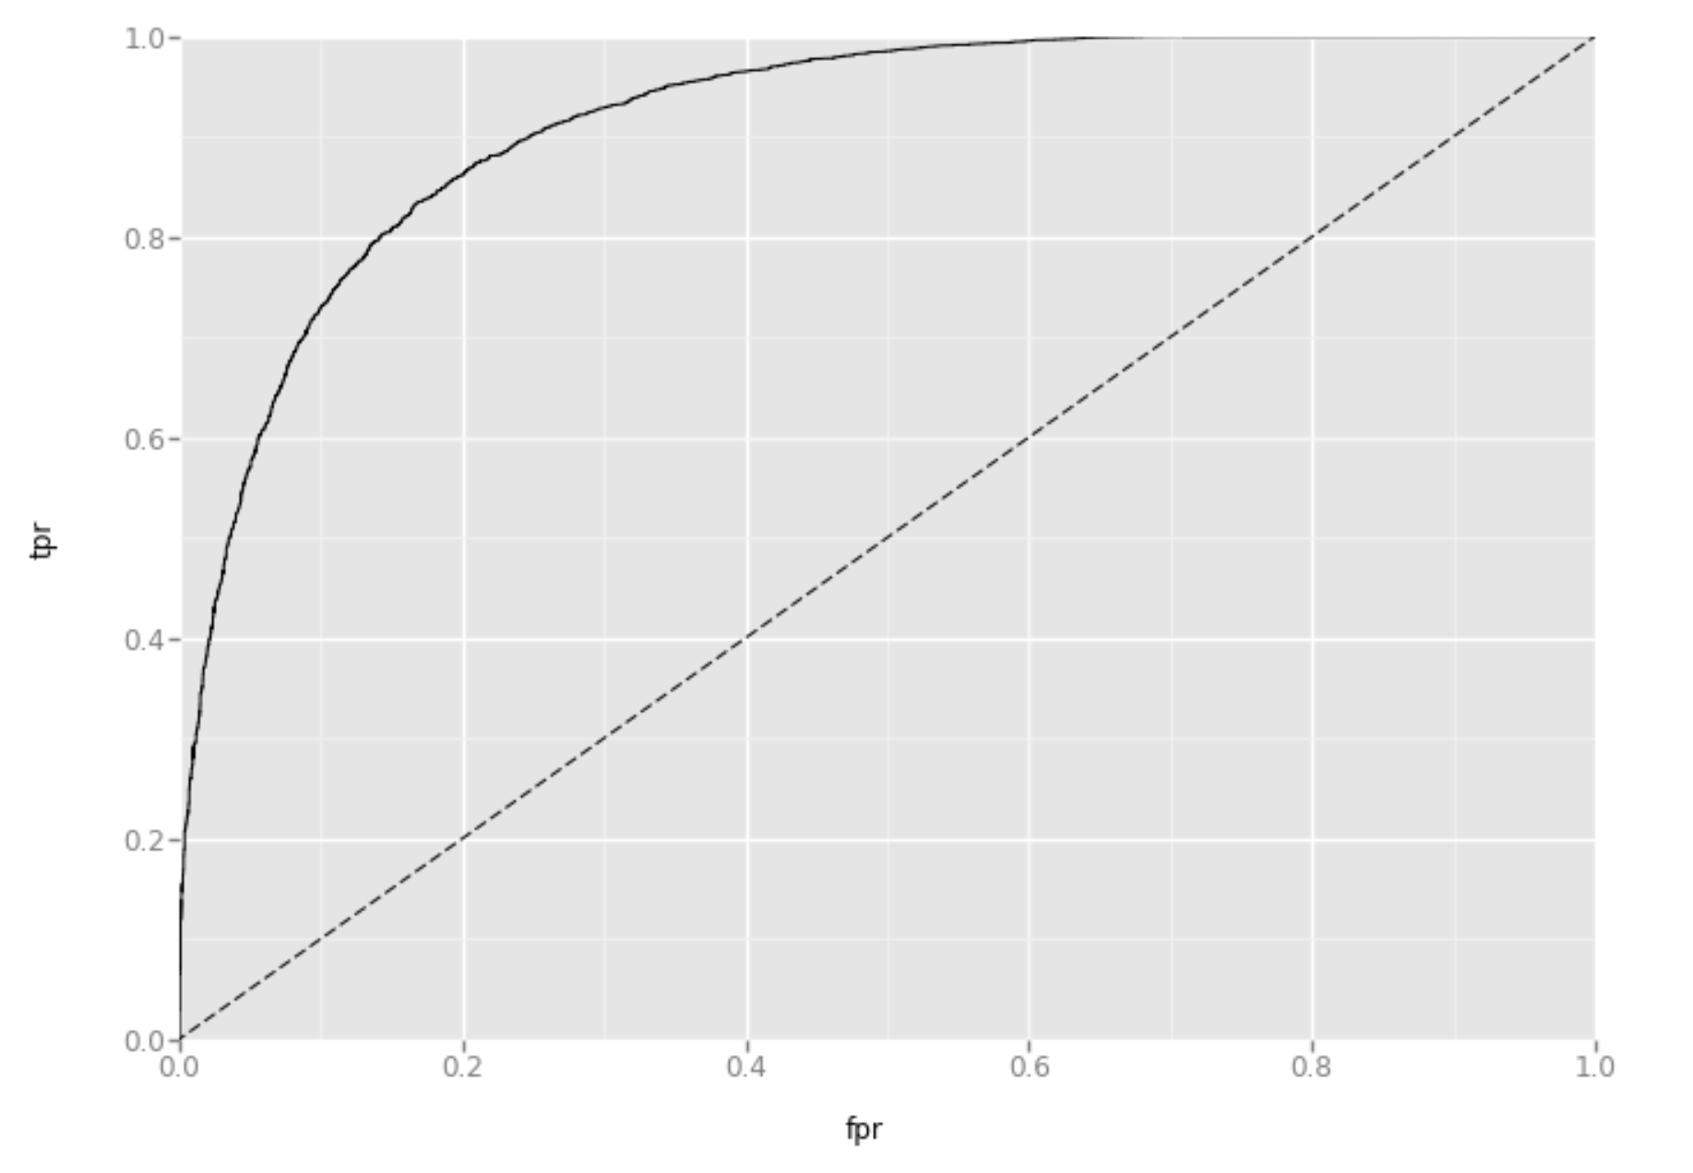
Model Results
AUC = 0.90855
False Positive Rate = 21.8%
False Negative Rate = 12.8%

Slide 12
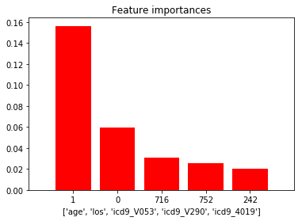
Web App
http://127.0.0.1:8050/

Slide 13
Scrapped Features
Patient Weight
Not available for all patients
Limited data from 46k cases -> 14k cases
Drug Codes
Not a reliable way to look up codes

Slide 14
Pros and cons of dataset
Pros
Easy to tell if patient has heart disease
Includes some information on personal history of substance use (ex. tobacco)
Includes patient’s family history of heart disease (ie. if icd_V173 is True)
Near perfect 50/50 split of heart diseased patients/non-heart diseased patients
Cons
Doesn’t detail all factors of a subject that would be helpful (ex. diet)
All patients from America

Slide 15
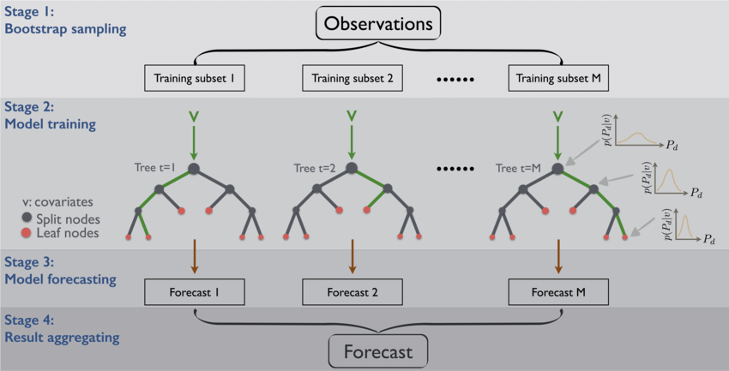
Random Forest
Bootstrapping
Decision Trees
Bagging

Slide 16
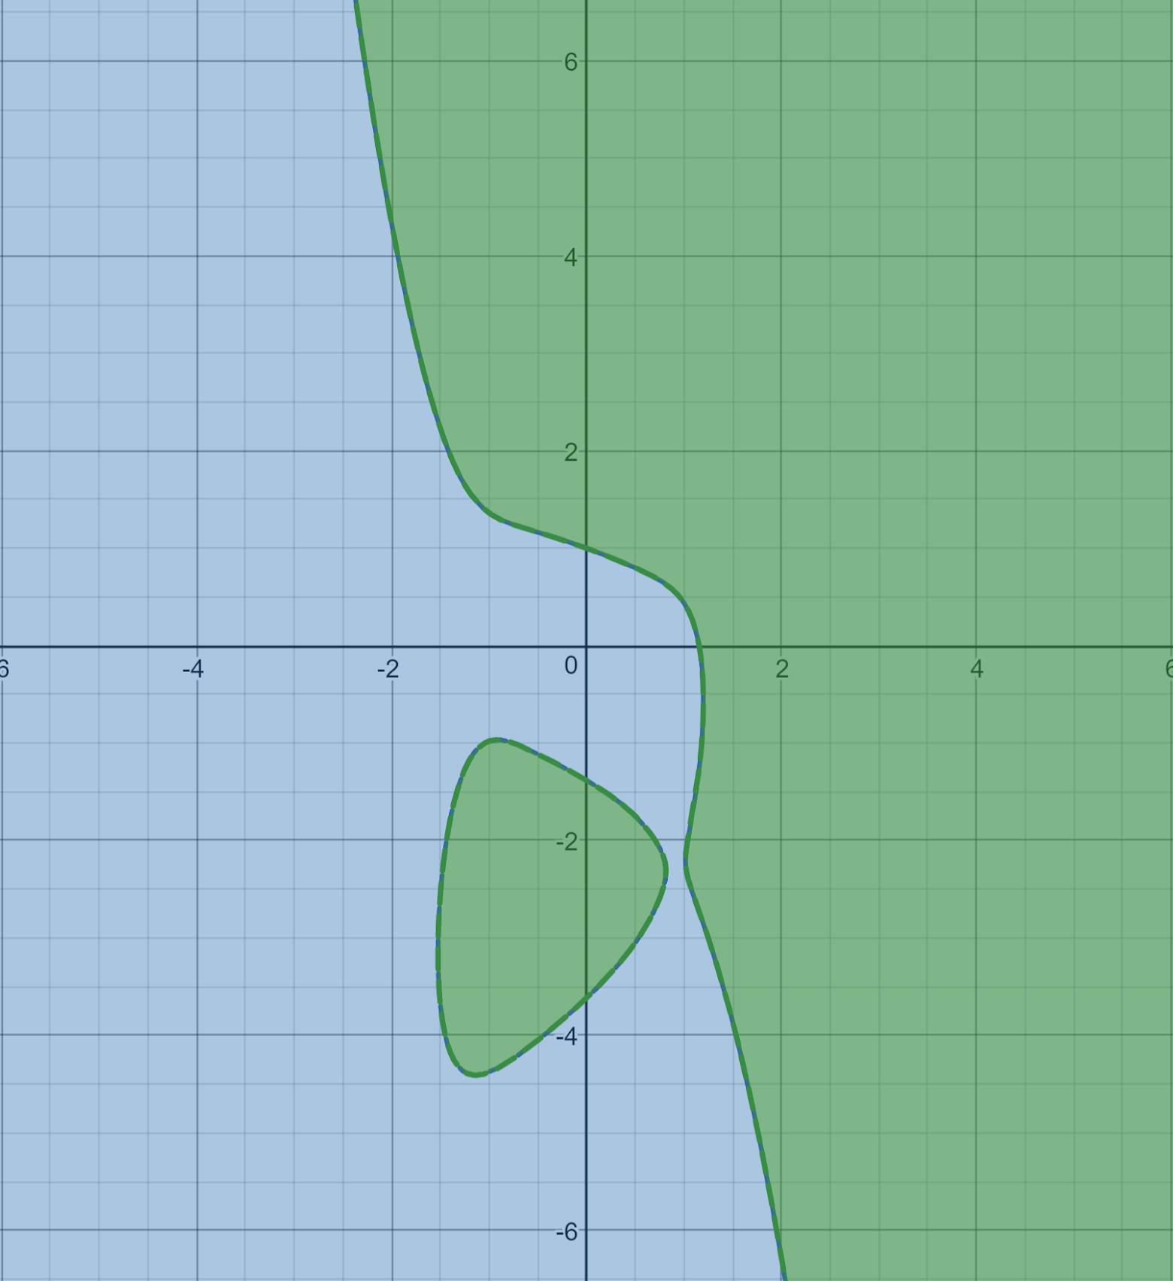
Logistic Regression
f(x) = x²
f(x₀, x₁, x₂ … x_{n}) = x₀ + a₁x₁ + a₂x₂ … a_{n}x_{n}
x -> x^{s} or x_{y}x_{z} or both
Prone to overfitting

Slide 17
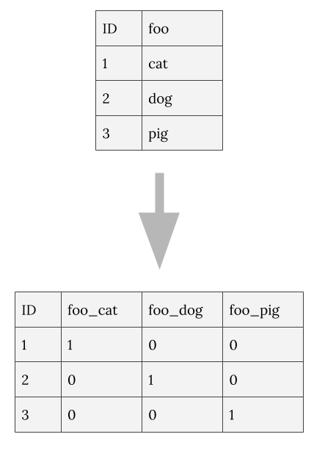
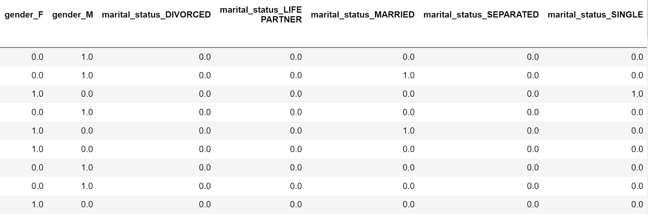
One Hot Encoding
One feature -> Many features
Gives everything the same weight

Slide 18
Potential Improvements to Model
Remove infant data
Include prescription drugs
Get information on diet
Gather more data

